Slide 1
“A quote which should not exceed the size of the textbox (two lines.)”
Meet FirstName -- The Achiever
Provide a short description that summarizes the persona, specifically related to using RetroQuest. Include information that is not made explicit in the blank. This description should not exceed the size of this textbox.….
First Name, Last Name
PERSONAL VALUES
Value 1
Value 2
Value 3
GOALS
Goal 1
Goal 2
Goal 3
Job Title, Division
Age
Marital Status
Income
# of Project
Device
Software
29
Single
65k +
3
Cellphone + + + + +
Laptop + + +
PC +
Slack + + + + + +
Trello + + + +
MOTIVATIONS
Motivation 1
Motivation 2
Motivation 3
CHALLENGES
Challenge 1
Challenge 2
Challenge 3

Slide 2
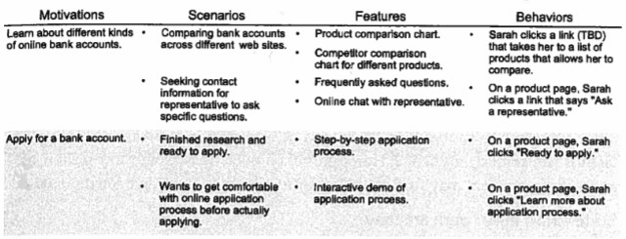
First Name - Scenario
From the persona, follow the motivation → scenarios → features → behaviors guideline to develop a paragraph of success case scenario where the persona uses RetroQuest.

Slide 3
Ashley - Best Case Scenario
Planning a trip in Detroit for Spring Break. Opens Google Map to see tourist attraction locations.
Sees Hellenic Museum right next to the Detroit Institute of Arts, clicks the link to visit the site.
Scroll over the front page to search for a quick intro and visiting info. Finds that it only opens on Sunday and it fits her schedule.
Clicks the ‘exhibition’ page to see what to expect. Browses through the images and themes and gets more interested.
Clicks the ‘explore the Greek community in Detroit’ page and adds more spots to her trip schedule for that day.
Clicks the ‘events’ page and adds the upcoming Marching Band event in Greektown Detroit into her calendar.
Clicks the ‘about us’ page to quickly glance through the history of the museum. Adds the museum to her schedule.
Notes:
She usually goes to Google Search to collect related information of the museum including opening hours, price, location, the introduction of exhibitions, reviews, and pictures to evaluate if she wants to visit.

Slide 4
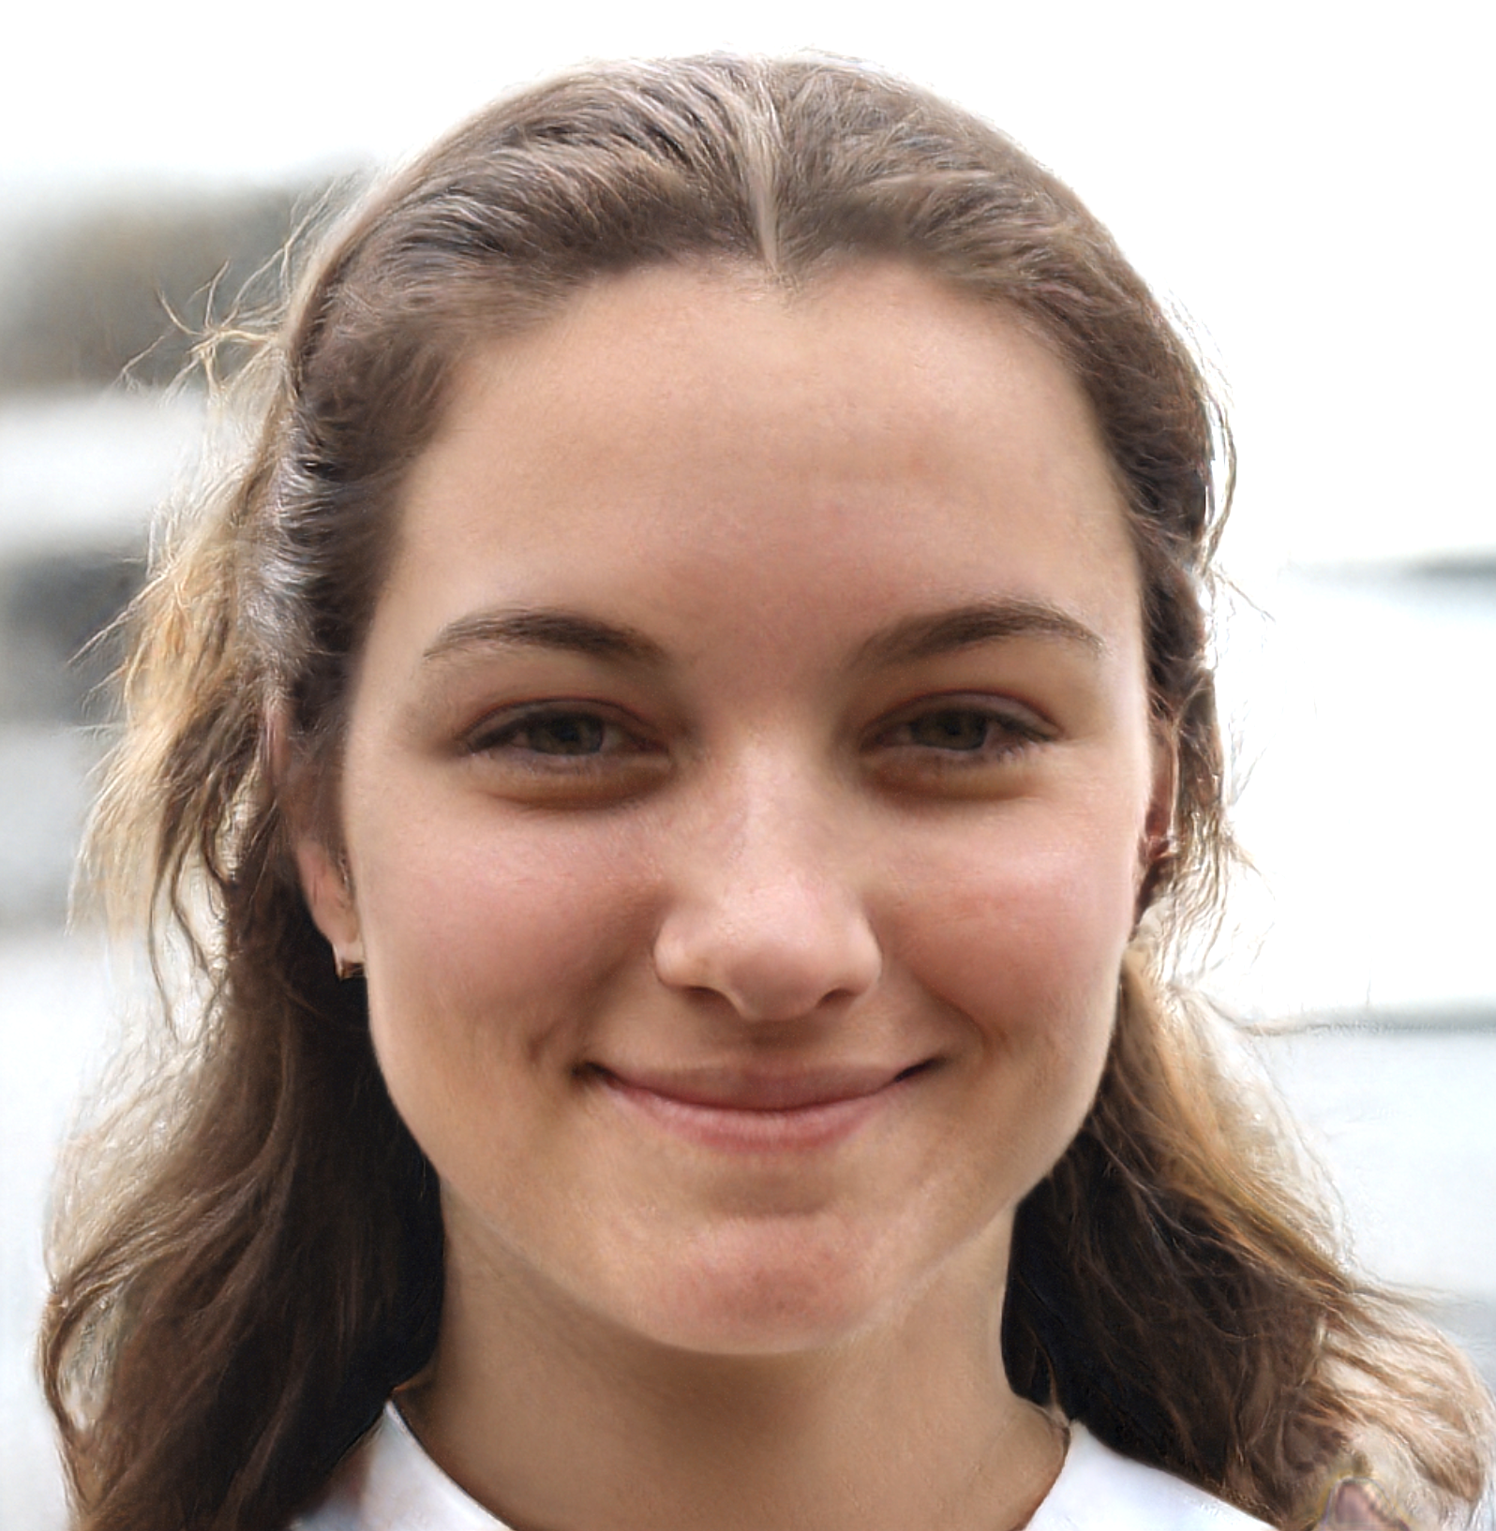
“As an in-depth travel lover, I want to explore places that helps me learn about the culture and history of a city.”
GOALS
Spiritual growth
Learn more about architecture through travel
Learn about local histories and communities when traveling
BIO
Ashley is a third-year OSU Architecture student who loves to explore the history of the cities and the buildings while traveling. She enjoys visiting museums to expand her knowledge in the local community and history, so she always includes local museums for her backpacking travel. She also likes to post beautiful pictures on social media to share her travel moments and uses the platform as a tool to collect the inspiration for her architecture assignments. Ashley usually Googles for related information of the museum to evaluate if she wants to visit it, and learns more details on the museum website.
MOTIVATIONS
Planning for an upcoming trip
Share photos and insights with friends during travel
Get inspired from buildings and exhibitions during travel
Ashley the Backpacker
Age
Profession
Education
Location
Interests
Devices
App/Website
20
Senior college student at OSU
B.S. in Architecture
Columbus, OH
Travel, World Music, Reading, Foodie
iPhone, MacBook
Google Search, Instagram, Facebook
FRUSTRATIONS
Hard to evaluate whether to visit or not because of too little information about the museum online
Not enough image to know what to expect
Outdated style and information lowers her interest
Low
High
Openness to new exp.
Organizational skills
Involvement
Notes:
Will plan to visit special tourist attraction while traveling
Planing before trip
Social media moment
Go to the museum website to plan the trip
Like history and context of the building/architecture and art
Visual
Numbers
Details
Check-ins with meaningful description

Slide 5
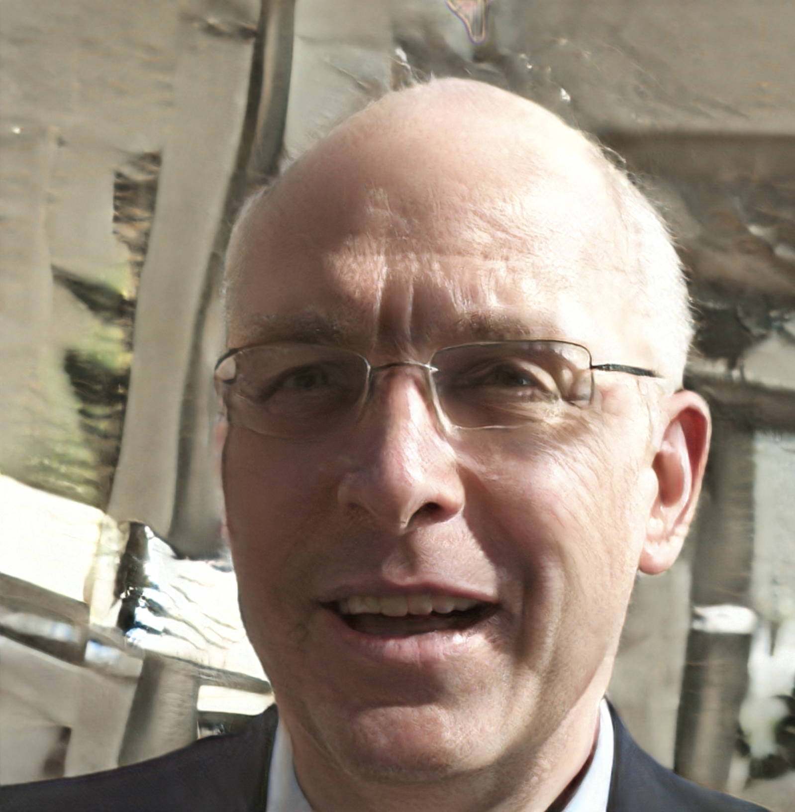
“We need to reach out to the community and younger generation...or this museum may not sustain. We don’t even know if people come to our website.”
GOALS
Increase website exposure
Revive and foster the Greek community in Greater Detroit
Collaborate with and support other Greek-related organizations
Increase the donation and membership of the musem
George the Enthusiast
BIO
As a retired attorney, George found his new life in participating community work, one of which is to co-run the Hellenic Museum of Michigan. However, since the economy went bad several years ago, the then prosper Greek Town does not feel so Greek anymore. Restaurants were replaced by with chain stores, and the community has gotten smaller. George worries the most about the museum business under the impact of the dwindling Hellenic group. Without the connection and input younger generations, the museum could be forced to close in the future.
MOTIVATIONS
Attract younger Greek descendents to the community
Get more volunteers for the museum
Get visualizsed analytics to see the demographic of visitor population
Age
Profession
Education
Location
Interests
Devices
App/Website
68
VP of HMM
Retired attorney
JD, Labor and employment studies
Detroit, MI
Dancing
iPhone
Messaging, Facebook
FRUSTRATIONS
Hard to draw the younger generation to the museum and pass the Greek culture and value of Greek history to them
Lack of manpower
Low
High
Openness to new exp.
Organizational skills
Involvement
Notes:
http://archives.cnd.org/HXWK/author/CHEN-Ji/cm0401a-7.gb.html

Slide 6
George - Best Case Scenario
Planning a trip in Detroit for Spring Break. Opens Google Map to see tourist attraction locations.
Sees Hellenic Museum right next to the Detroit Institute of Arts, clicks the link to visit the site.
Scroll over the front page to search for a quick intro and visiting info. Finds that it only opens on Sunday and it fits her schedule.
Clicks the ‘exhibition’ page to see what to expect. Browses through the images and themes and gets more interested.
Clicks the ‘explore the Greek community in Detroit’ page and adds more spots to her trip schedule for that day.
Clicks the ‘events’ page and adds the upcoming Marching Band event in Greektown Detroit into her calendar.
Clicks the ‘about us’ page to quickly glance through the history of the museum. Adds the museum to her schedule.
Notes:
She usually goes to Google Search to collect related information of the museum including opening hours, price, location, the introduction of exhibitions, reviews, and pictures to evaluate if she wants to visit.

Slide 7
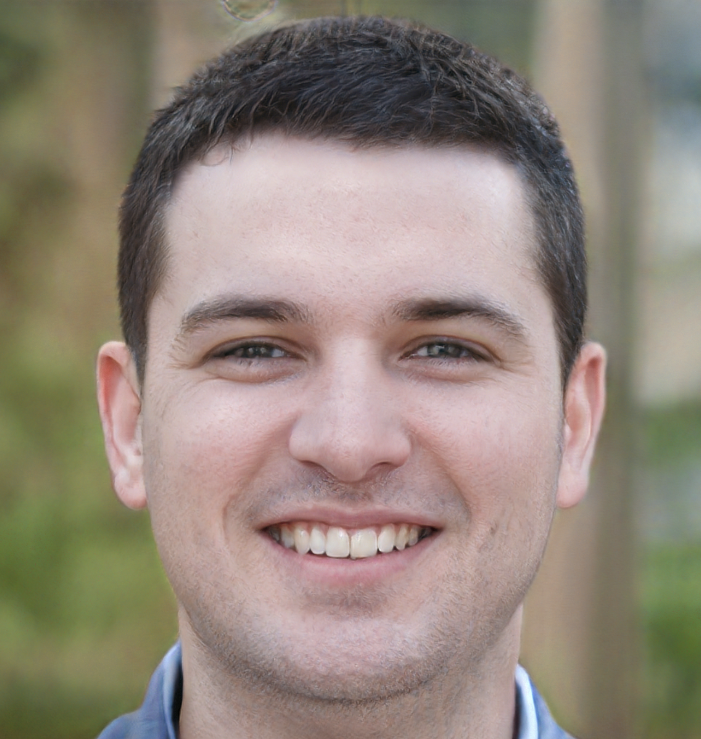
“As an in-depth travel lover, I want to explore places that helps me learn about the culture and history of a city.”
BIO
Ashley is a third-year OSU Architecture student who loves to explore the history of the cities and the buildings while traveling. She enjoys visiting museums to expand her knowledge in the local community and history, so she always includes local museums for her backpacking travel. She also likes to post beautiful pictures on social media to share her travel moments and uses the platform as a tool to collect the inspiration for her architecture assignments. Ashley usually goes to Google Search for related information of the museum to evaluate if she wants to visit, so she wants to be able to collect information on the museum website.
GOALS
Spiritual growth
Learn more about architecture through travel
Learn about local histories and communities when traveling
Sam the Enthusiast
MOTIVATIONS
Planning for an upcoming trip
Share photos and insights with friends during travel
Get inspired from buildings and exhibitions during travel
Age
Profession
Education
Location
Interests
Devices
App/Website
38
Greek Deli owner
in downtown Detroit
B.A in Psychology
Greek Town, Detroit
Food, Literature, Movie, Church life
Samsung mobile, PC
Facebook, Yelp, NPR
FRUSTRATIONS
Hard to evaluate whether to visit or not because of too little information about the museum online
Not enough image to know what to expect
Outdated style and information lowers her interest
Low
High
Openness to new exp.
Organizational skills
Involvement
Notes:
Will plan to visit special tourist attraction while traveling
Planing before trip
Social media moment
Go to the museum website to plan the trip
Like history and context of the building/architecture and art
Visual
Numbers
Details
Check-ins with meaningful description

Slide 8
Ashley - Best Case Scenario
Planning a trip in Detroit for Spring Break. Opens Google Map to see tourist attraction locations.
Sees Hellenic Museum right next to the Detroit Institute of Arts, clicks the link to visit the site.
Scroll over the front page to search for a quick intro and visiting info. Finds that it only opens on Sunday and it fits her schedule.
Clicks the ‘exhibition’ page to see what to expect. Browses through the images and themes and gets more interested.
Clicks the ‘explore the Greek community in Detroit’ page and adds more spots to her trip schedule for that day.
Clicks the ‘events’ page and adds the upcoming Marching Band event in Greektown Detroit into her calendar.
Clicks the ‘about us’ page to quickly glance through the history of the museum. Adds the museum to her schedule.
Notes:
She usually goes to Google Search to collect related information of the museum including opening hours, price, location, the introduction of exhibitions, reviews, and pictures to evaluate if she wants to visit.

